Slide 8
E
R

Slide 15

Slope
variability
Underlying
Geology
Management
history
Disturbance
regime

Slide 16



Particulate yield

Slide 17
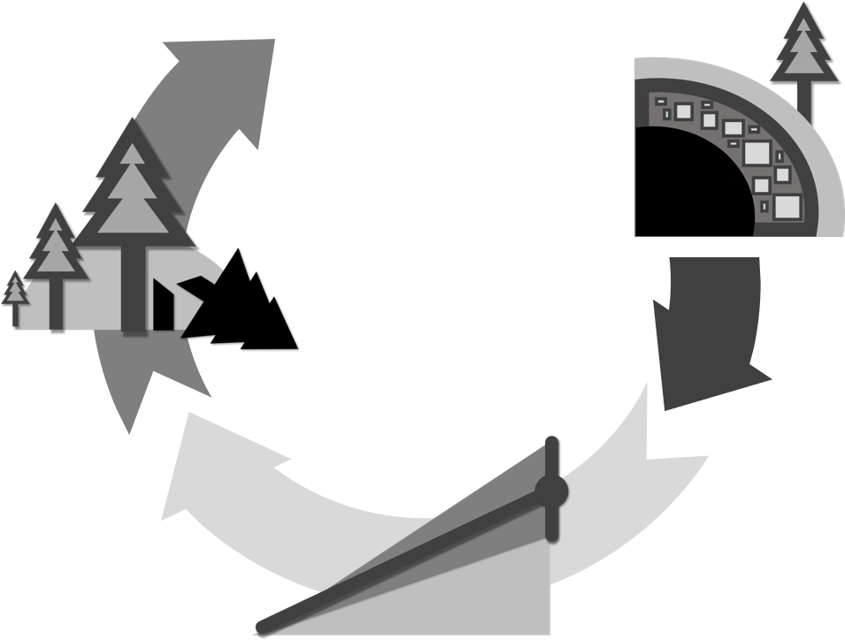
Disturbances as outliers
It’s difficult to find proxies for them beyond the response variables.
Particulate yield
Bywater-Reyes et al., 2017
Bywater-Reyes et al., 2020

Slide 18

Particulate Organic
Carbon yield
Bywater-Reyes et al., 2017
Bywater-Reyes et al., 2020

Slide 19


Slide 20







Slide 21

Particulate Organic
Carbon yield?
While controlling for geology effects we explore the interaction of additional factors with a deeper dive into the role of contrasting landscape configuration and history on POC yields.
That also help us to focus on the surface process, since we know that most POC is eroded from the forest floor and O-horizons

Slide 22
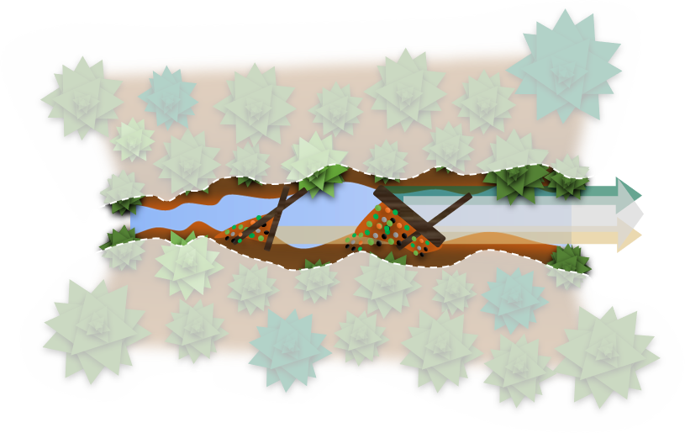
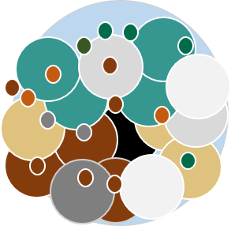

Slide 23
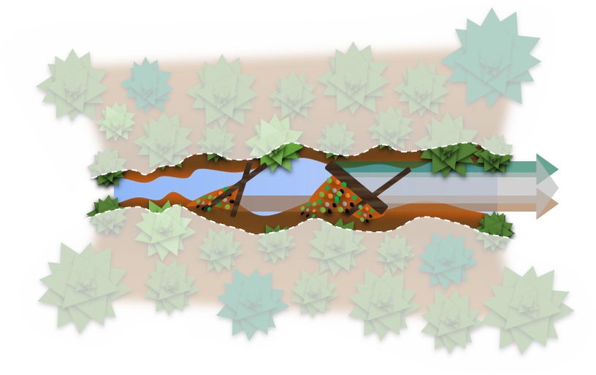
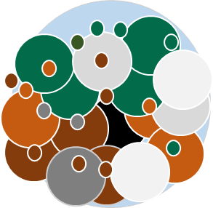
Particulate Organic Carbon yield
Density
POC yield
Hillslope
Carbon-rich particles
at low POC yields
Stream channel
Total yield
Coniferous
vegetation
Sediment
particles
Mixed
detritus
Carbon Rich-Mineral Poor
(e.g., fresh litter inputs)
Carbon-poor particles
at high POC yields
Instream retention structures
(e.g., large woody debris)
Mineral Rich-Carbon Poor
(e.g., mineral soil)

Slide 25
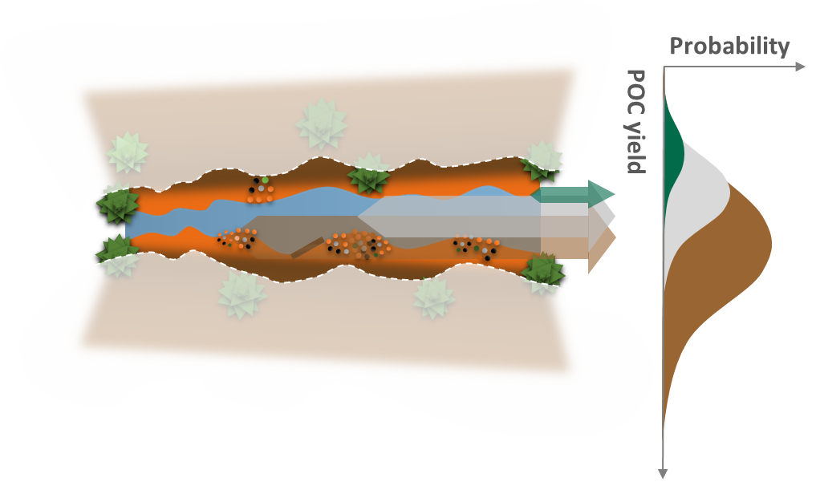
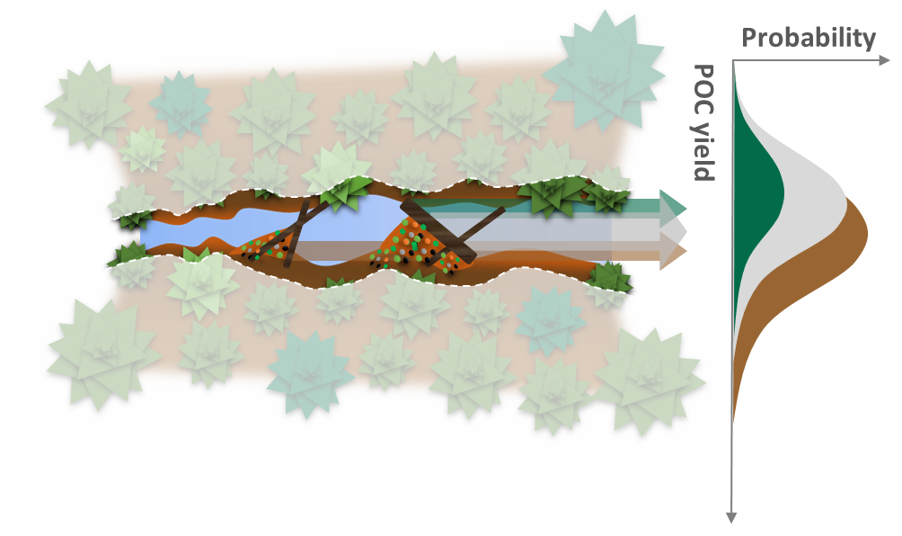
Old-growth
forest
Logged forest +
channel scouring event

Slide 26
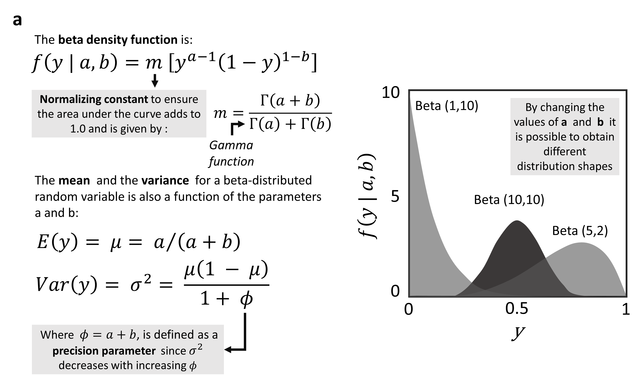

Slide 27
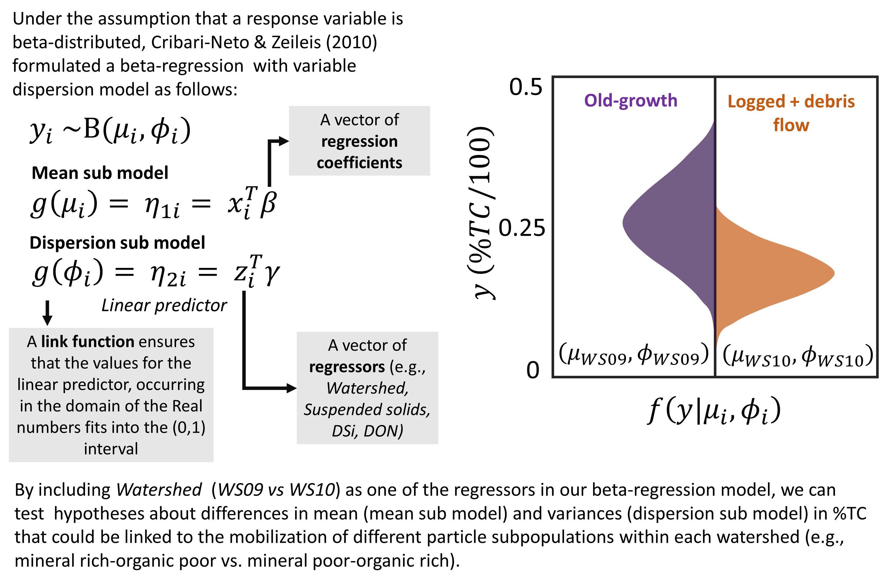

Slide 28
Predicting Particulate Organic Carbon yields in headwaters
with contrasting landscape configuration and history
Slope Variability
TSS & Discharge
Based on Safeeq et al., it makes sense to break the effect of particle yield into Discharge and TSS effects
Management History
DON
Versevel et al., 2009 The role of hillslope hydrology in controlling nutrient loss
Disturbance Regime
DSi
Monthly DSi exports from these watersheds (because changes occur in variance but not in mean)
Alterations to the channels structure are one of the most important effects of disturbance in headwaters (?)- Process domain

Slide 29
Ggplot 2.0 Data Visualization
Figure 9. Long-term (1984-2015) seasonality and composition of the particulate organic carbon (POC) exported from two headwater streams draining an old-growth forest (WS09-OG site) and a 100%-logged watershed (WS10-LG site) in the H. J. Andrews Experimental Forest. Solid, thick, red lines represent smoothed trends estimated with LOESS regression (smoothing parameter (α)=0.5, the light-shaded region represents 95% confidence intervals around the smoothed trend). The categorical color scale for %TC represents approximately sediment sources identified by Smith (2013): 5-10% surface soils, 11-16% mixed detritus, >17% litter and vegetation. Temporal changes in the proportion of %TC categories are shown in the insets in (a) and (c). Stacked kernel density distributions on the right showing the contribution of different sediment sources to the overall POC yield (b and d, with unstacked versions of the density plots as insets to aid interpretability).

Slide 30


Particulate Organic
Carbon yield?
Old-growth forest
While controlling for geology effects we explore the interaction of additional factors with a deeper dive into the role of contrasting landscape configuration and history on POC yields.
Logged forest + channel scouring event
That also help us to focus on the surface process, since we know that most POC is eroded from the forest floor and O-horizons

Slide 31
A 30-year record of Biospheric Particulate Organic Carbon Export from Two Small Forested Catchments with Contrasting Landscape Organization and Disturbance History
Probability
Old-growth forest
Carbon-rich particles
at low POC yields
POC yield
Hillslope
Total yield
Stream
channel
Coniferous
vegetation
Mixed
detritus
Logged forest + channel scouring event
Carbon-poor particles
at high POC yields
Sediment
particles
Carbon Rich-Mineral Poor
(e.g., fresh litter inputs)
Instream retention structures
(e.g., large woody debris)
Mineral Rich-Carbon Poor
(e.g., mineral soil)

Slide 32

Particulate Organic
Carbon yield?
While controlling for geology effects we explore the interaction of additional factors with a deeper dive into the role of contrasting landscape configuration and history on POC yields.
That also help us to focus on the surface process, since we know that most POC is eroded from the forest floor and O-horizons

Slide 33



A 30-year record of Biospheric Particulate Organic Carbon Export from Two Small Forested Catchments with Contrasting Landscape Organization and Disturbance History
Old-growth forest
Probability
Carbon-rich particles
at low POC yields
POC yield
Hillslope
Total yield
Stream
channel
Coniferous
vegetation
Mixed
detritus
Logged forest + channel scouring event
Carbon-poor particles
at high POC yields
Sediment
particles
Carbon Rich-Mineral Poor
(e.g., fresh litter inputs)
Instream retention structures
(e.g., large woody debris)
Mineral Rich-Carbon Poor
(e.g., mineral soil)

Slide 34


Particulate Organic
Carbon yield
The superposition of management practices and disturbance events resulted in divergent POC dynamics. At least two types of carbon flux regulation, i.e., erosional and biogeochemical may coexist in the Oregon Cascades. Predicting the impacts of a more frequent disturbances on carbon fluxes requires to incorporate these regimes in our modeling efforts.

Slide 35
Slope Variability
Geology
Disturbance regime
Management history

Slide 36
Particulate Organic
Carbon yield

Slide 37
Particulate Organic
Carbon yield

Slide 38
1984-1986
1986-1996
1997-2006
2007-2016

Slide 51
Slope Variability
Geology
Disturbance regime
Management history
Erodible
Resistant

